Slide 1

CSC485B Machine Learning for Robotics
SUNY Plattsburgh
Dr. Ned Lecky
Class 01- Overview and Discussion

Slide 2
Machine Learning for Robotics?
OK: What’s Robotics?
“A bunch of motors and sensors hooked up to a computer that we have to figure out how to program.” – Ned Lecky
I’ve done it at Amazon, Microsoft, Google, Intrinsic, and now in my own little company www.lecky.com
The challenge: it takes mechanics, electronics, computer hardware, cameras, lighting, optics, and LOTS of software to get even the simplest things done
Simplifying the programming and adding “intelligence” (“robustness”) to the code is a major focus- and it’s going very slowly

Slide 3
Background Media
General Overview- 3 Minutes
https://www.youtube.com/watch?v=Cndodc3X50s
Fanuc- Good 14-minute overview AND…
last 2 minutes talks about “AI”
https://www.fanuc.co.jp/en/product/video/index.html
Market and Issues
https://www.marketsandmarkets.com/Market-Reports/Industrial-Robotics-Market-643.html

Slide 4
Machine Learning for Robotics?
OK: What’s Machine Learning?
“A set of data analysis algorithms that may be able to tune themselves based on feeding them your data so you can get a working program without having to actually figure out what’s going on and code it all explicitly yourself.” – Ned Lecky
Human Learning is a similar but different thing and might have similarities and differences and we just, we just, we just… don’t understand it very well at this time!
Some disagreement on what is ML…or is ML part of AI… Linear Regression? Monte Carlo methods?
The challenge: there are LOTS of techniques and algorithms available and each has numerous hyperparameters (“twisty knobs”) to play with to try to get them to work
Simplifying the programming and adding “intelligence” (“robustness”) to the code is a major focus- and it’s going very slowly

Slide 5
Background Media
The “easiest” and well-known ML library
Scikit-learn (sklearn): https://scikit-learn.org/stable/
Others that we’ll look at are primarily focused on accelerating training and operation of Artificial Neural Networks
Pytorch
Keras/TensorFlow
Many others
Learn scikit-learn and you can pick up any of them

Slide 6
Um, ML vs. Deep Learning vs. AI?
“DL is an extension to ML, which is a part of AI” – Ned Lecky
But there are other ways to think about it!
https://en.wikipedia.org/wiki/Machine_learning
The most important thing to realize
We can use existing “ML” or ML-like libraries
We can also invent our own new ML algorithms that might be
Quite application specific, and
More “performant”

Slide 7
The Dangers of Anthropomorphism
The computer isn’t sentient or alive or thinking
It runs a program written by people (or a program written by a program that was written by people)
Phrases like “it learns,” words like “perception,” “decides,” “understands,” these are all quite seductive and incorrect- and simultaneously we overestimate and underestimate what ML is!
People (and animals) do those things, computer don’t: No Judgement
The same is happening in robotics-

Slide 8
Intro to Intro to ML
That scikit-learn library is the place to start
https://scikit-learn.org/stable/
Let the algorithm configure itself by reading data (Learning)
Typical Applications
Classification
Regression
Dimensional Reduction
Big things (Autonomy, Planning, Sensor Fusion… that use the above in various ways)
Types of Learning
Instance-based vs. Model-based “Learning”
Supervised vs. Unsupervised vs. Reinforcement “Learning”
On-line vs. Batch vs. Continuous “Learning”
OK, I’ll drop the quotes around Learning but please remember why I might put them in

Slide 9
Now: How About Our Class?
This is an applied ML course
We will pick problems of interest in automation/robotics/vision and try solving them with various ML techniques
Step One: Programming Environments and Tools
Step Two: ML Framework and Helper Libraries
Step Three: Examples and Applications
Step Four: A project of your choosing

Slide 10
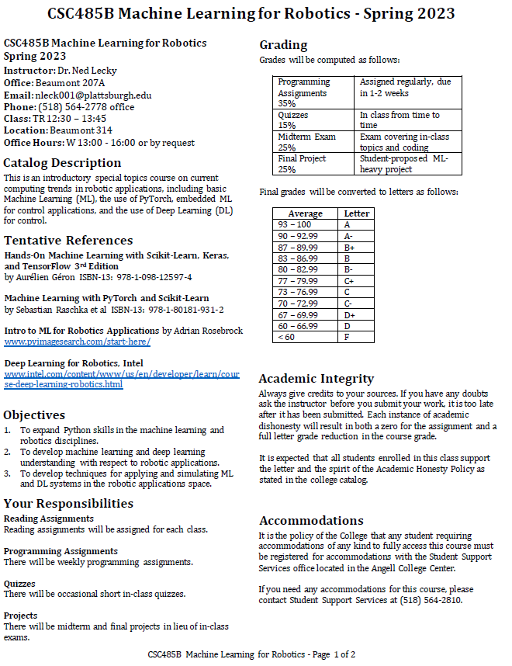
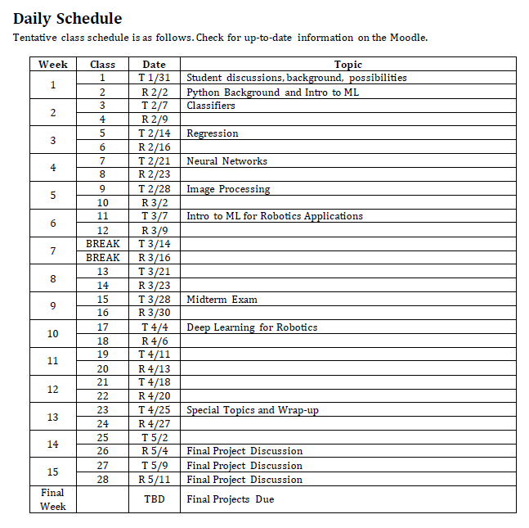
Syllabus Review and Discussion
Here’s our chance to adjust based on surveys on the next 2 pages

Slide 11
Survey: Background
So what have you worked with and how much time should we spend on review?
How broad is your Python experience?
Platforms: Colab, Jupyter Notebooks, Anaconda, Windows/.NET
Lists vs. Tuples vs. Sets vs. NumPy
Object oriented (Classes)?
How are your library skills?
NumPy
SciPy
Pandas
Matplotlib
Scikit-learn??
Keras, Jax, TensorFlow, …..
Any prior background in AI, ML, neural networks??

Slide 12
Survey: Interests
What are we interested in?
Identification/Perception?
General Computer Vision?
SLAM: Localization and Mapping
Sensor Fusion?
Planning and Control?
Motion Planning?
Trajectory Optimization?
Continuous Replanning?
Object Identification?
Defect Detection?
Anomaly Detection?
RL: Planning vs. Policies? (NetLogo and beyond…)
Human Robot Interaction?
Learning from Humans?
Reactive Control?
Autonomy?
Industrial Applications?
Chat GPT?
Other?

